Slide 1


Introduction to
Robotic Process Automation
ID CARD GENERATOR
Your Register No.220701004
Name : ABHILASH A
Guide Name : Mrs. J. Jinu Sophia
Designation : Designation : Assistant Professor (SG)
Department : Computer Science and Engineering

Slide 2
Abstract
This project focuses on automating the creation of ID cards using UiPath, combining data from an Excel sheet with a Word template. The system processes structured information like names, IDs, departments, and photos to generate personalized ID cards efficiently and accurately. The project eliminates manual efforts, reduces errors, and ensures a scalable solution for organizations.

Slide 3
Need for the Proposed System
Time-Saving Automation
Customization and Flexibility
Cost-Effectiveness
Scalability
Data Integration
Security Enhancements

Slide 4
Advantages of the Proposed System
Automation Efficiency
Data from Excel can be read row by row, and Word templates can generate
ID cards dynamically, reducing manual effort.
Perfect for repetitive tasks like producing hundreds or thousands of ID cards.
Error Reduction
Automation ensures consistency by fetching data directly from the Excel sheet,
eliminating manual entry errors.
Cost-Effectiveness
Uses widely available tools (Excel and Word) without the need for expensive or
specialized software.
Scalability
Easily scalable for small projects or large-scale needs such as schools, companies,
or events.

Slide 5
Literature Survey
PAPER 1 : Literature Survey Paper 1: Automating ID Card Generation Using Excel and Word Templates
Advantages:
Time Efficiency: Automates repetitive tasks, saving significant time for bulk card generation.
Error Minimization: Ensures data accuracy and consistency through dynamic content mapping.
Disadvantages:
Limited Security Features: Basic systems may lack advanced features like encrypted QR codes or watermarks.
Manual Oversight Required: Initial setup and template configuration may require manual intervention.
PAPER 2: "Literature Survey Paper 2: A Practical Approach to ID Card Generation in Resource-Constrained Environments"
Advantages:
Affordability: Uses widely accessible tools, reducing setup costs compared to commercial ID software.
Flexibility: Supports dynamic template modifications for different designs or use cases.
Disadvantages:
High initial setup costs due to cloud infrastructure.
Security concerns with cloud-based data storage.

Slide 6
Main Objective
The main objective of this project is to develop an automated and efficient system for generating personalized ID cards by integrating Excel as the data source and Word templates for design output. This system aims to streamline the creation of multiple ID cards, minimize human errors through dynamic data mapping, and save time and effort, particularly for large datasets. Additionally, it provides a scalable and cost-effective solution using widely available tools like Microsoft Excel and Word, making it suitable for both small and large organizations.

Slide 7
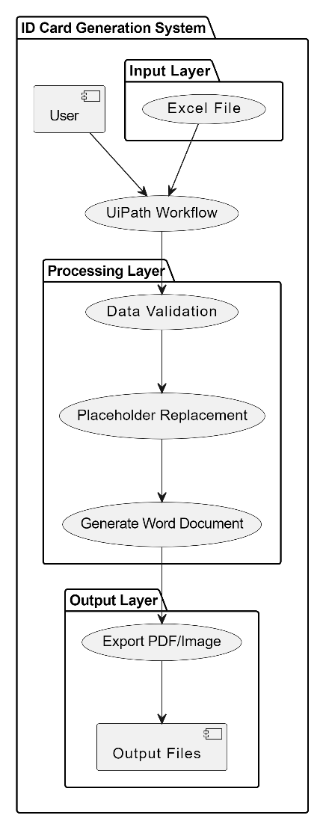
Architecture

Slide 8
System Requirements
Hardware
System with windows 11
Minimum ram: 8GB
Processor: Intel Core i3 or equivalent
Software
UiPath Studio
Microsoft word
Microsoft Excel

Slide 9
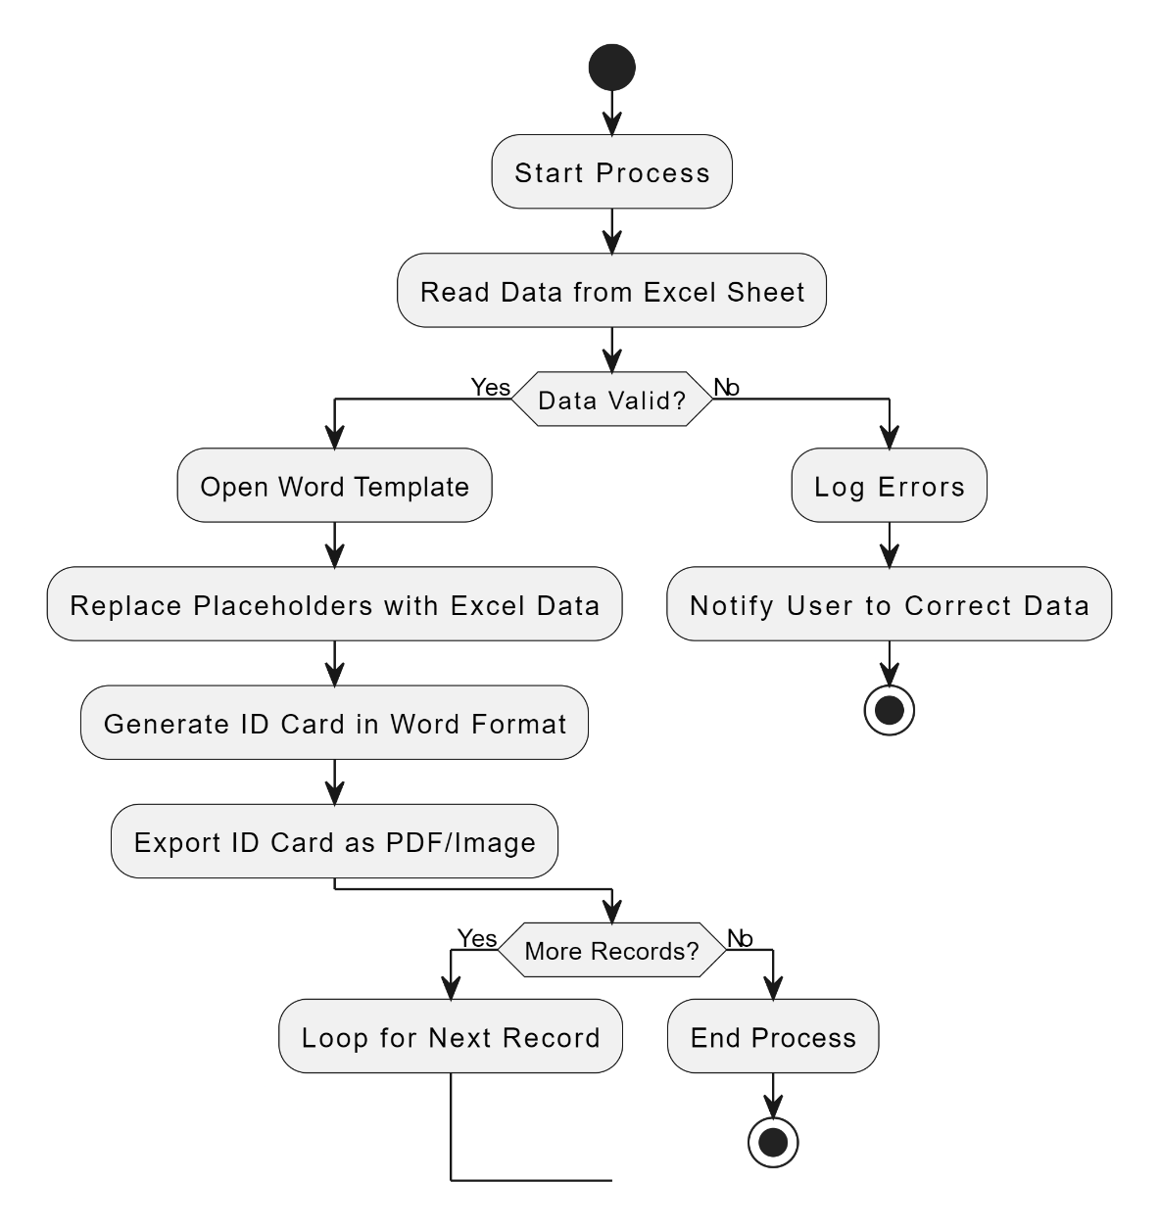
Functional Description

Slide 10
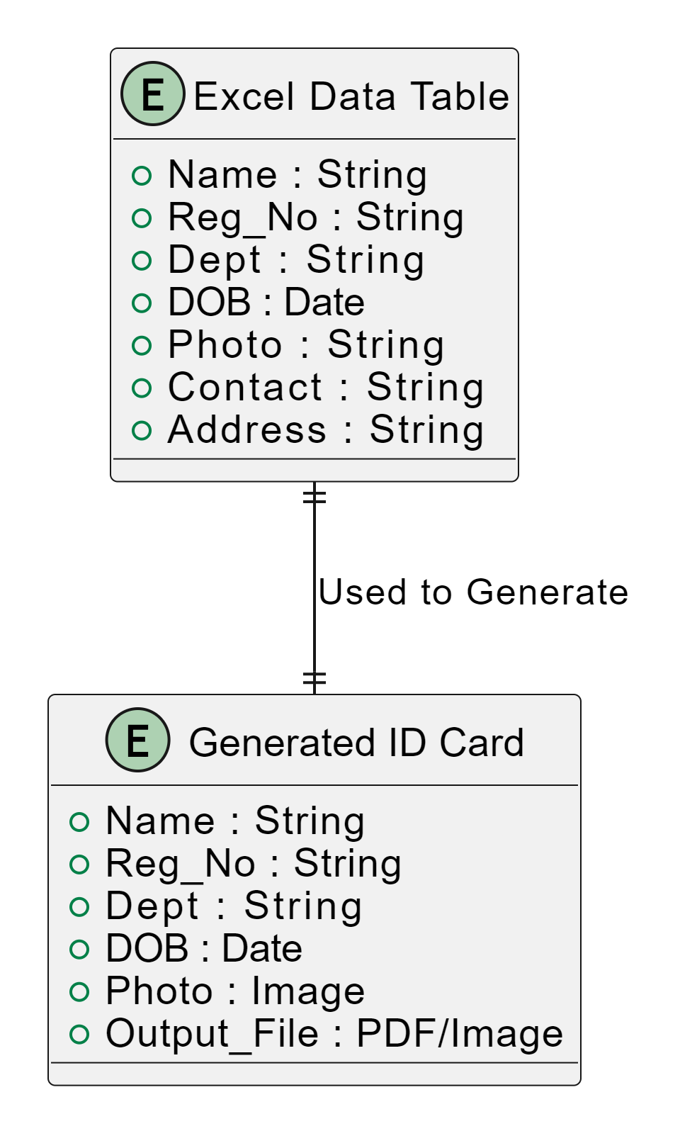
Table Design
E R DIAGRAM

Slide 11
Process Design
Start the Process The process begins by launching the UiPath workflow, which automates
the ID card
generation.
Load the Excel File The system reads an Excel file containing the required data fields, such as name,
registration number,
department, date of birth, photo file path, and contact details.
Validate the Data The workflow checks if the Excel data is valid. This includes ensuring all mandatory
fields are filled,
and the photo paths are correct.
Open the Word Template The pre-designed Word template, which contains placeholders for the ID card
information, is loaded into the workflow.
Process Each Row in Excel For every record in the Excel file, the following steps are repeated:
Placeholders in the Word template (e.g., <Name>, <Dept>) are replaced with actual data from the Excel file.
The photo corresponding to the record is inserted into the ID card.
Generate the ID Card The completed ID card is saved in a specified format, such as a PDF or
image file, and stored in the output folder.

Slide 12
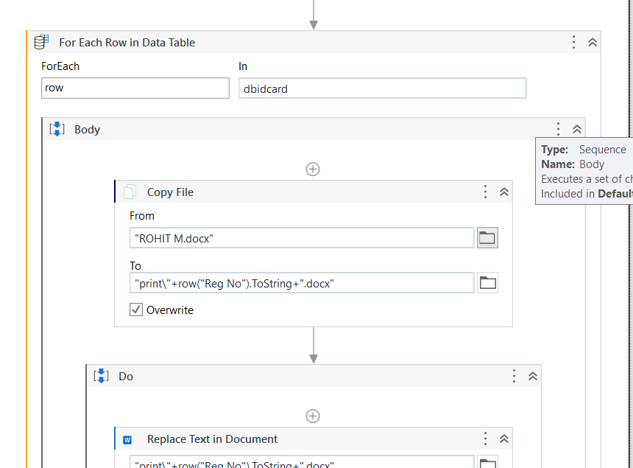
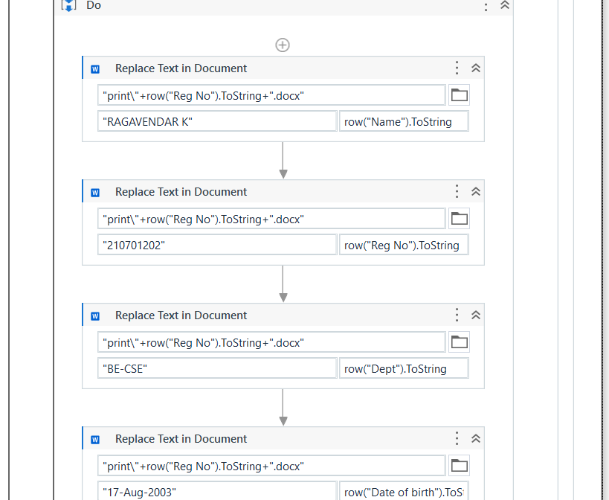
IMPLEMENTATION

Slide 13
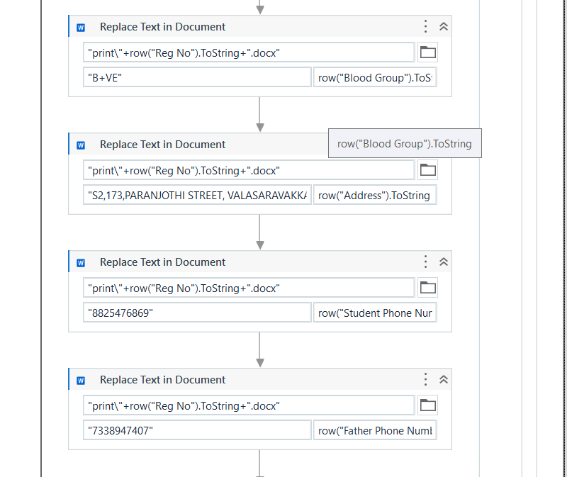
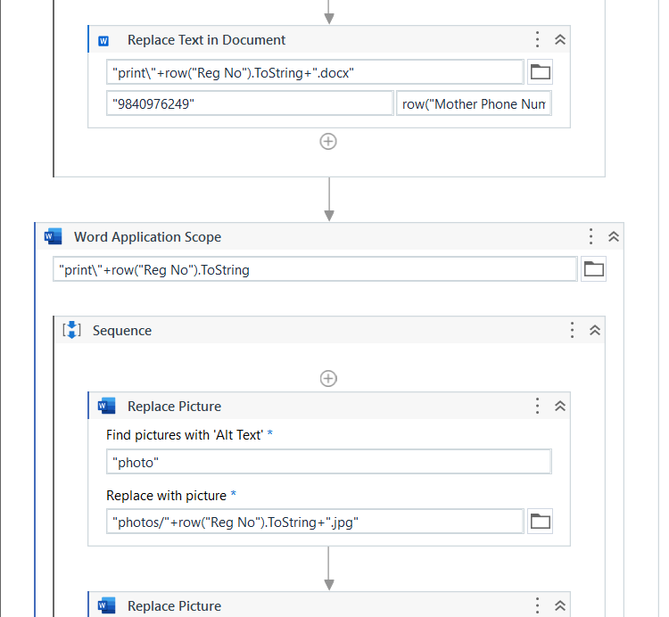
IMPLEMENTATION

Slide 14
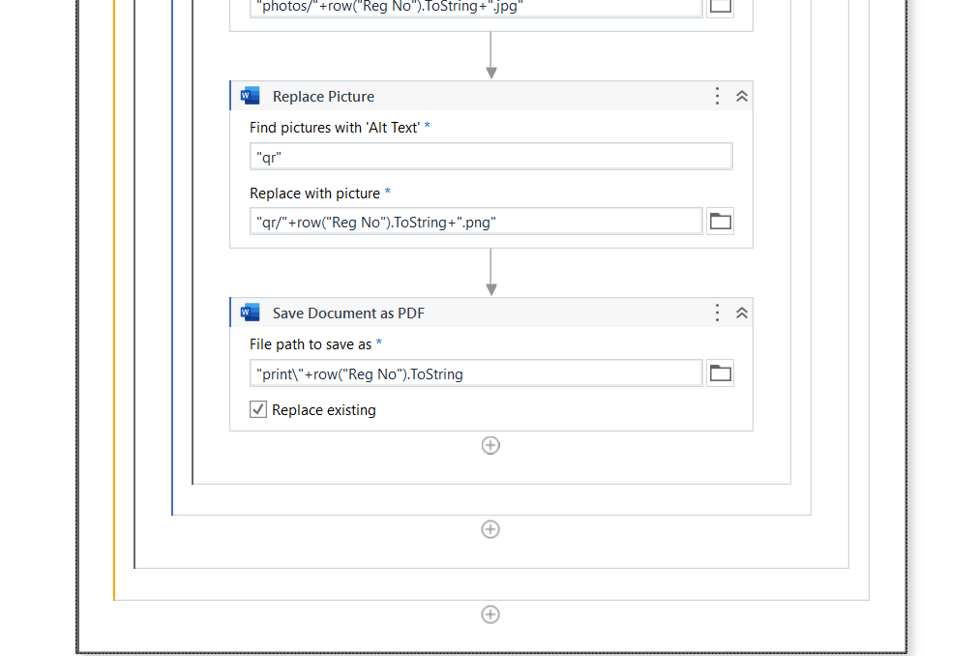
IMPLEMENTATION

Slide 15
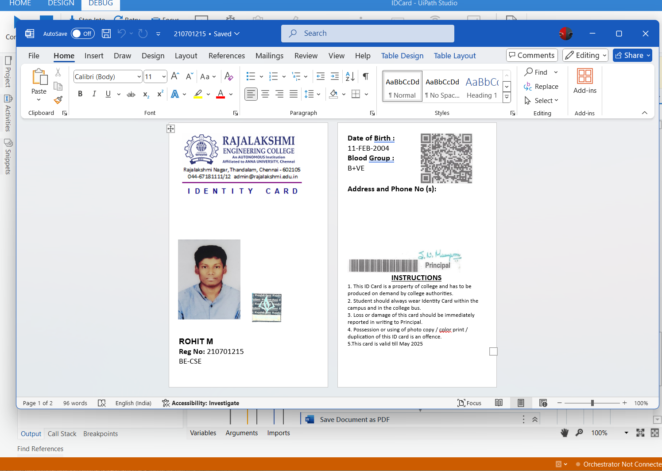
Testing
OUTPUT :
ID CARD

Slide 16
Conclusions
In conclusion, this ID card generation project transforms a traditionally time-consuming and error-prone task into an efficient, automated process. By using UiPath in combination with Excel and Word, the system effortlessly handles bulk data, fills in the necessary details, and creates professional ID cards quickly and accurately. This not only ensures consistency across all generated cards but also significantly reduces the potential for human errors. With the automation in place, organizations can now process large volumes of ID cards without the usual hassle. The project offers a practical solution that enhances productivity and provides a reliable framework, with room for future improvements, such as cloud integration and live previews, making it adaptable for growing organizational needs.

Slide 17
Future Enhancement
Cloud Integration Integrating the system with cloud services (e.g., Google Drive, Dropbox) can enable easier storage, access, and sharing of ID cards across different devices or departments. This would streamline the process for large organizations with multiple locations.
Real-time ID Card Preview Implementing a feature that allows users to preview ID cards in real-time before finalizing the generation would provide better control over the formatting and details, ensuring everything is accurate before saving or printing.
Automated Photo Capture Integration Instead of manually uploading photos for each individual, the system could be integrated with a webcam or digital camera to automatically capture and associate photos with each record in the Excel file. This would reduce manual work and speed up the process.
Security Features Adding security features, such as password protection for the generated ID card files or encrypted photo storage, could help safeguard sensitive information.

Slide 18
IEEE Paper
Title: "SmartIdOCR: Automatic Detection and Recognition of Identity card number using Deep Networks"
Authors: Manish Kumar Gupta ,onak Shah,Jitesh Rathod,Ajai Kumar
Conference: 2023 IEEE International Conference on RPA Abstract:
Identity authentication is much needed and required in this digital age where the information can be utilized in many areas like banking, finance, insurance, education, etc. The long time in the manual authentication process is tiresome for both sides due to the exchange of data. The challenge lies in verification and information extraction from the ID card during the authentication process. There is an AI-based solution needed to reduce the authentication time.

Slide 19
References
[1] International Journal of Research Publication and Reviews Journal homepage:www.ijrpr.comb ISSN 2582-7421
Generating Identity Card in RE Framework without Orchestrator
Queue using RPA UiPath
Sandhiya S, Asso. Prof. Mr. J. Jayapandian
https://ijrpr.com/uploads/V4ISSUE6/IJRPR14528.pdf.
[2] Step-by-Step: Building an Automated ID Card Generation System using Microsoft Power Virtual Agent
by PriyanshuSrivastav
https://techcommunity.microsoft.com/blog/educatordeveloperblog/step-by-step-building-an-automated-id-card-generation-system-using-microsoft-pow/3918257
[3] SIGSv2: Enhanced Student ID Generator and Management System
Conference paper @16 December 2020
pp 765–774
https://link.springer.com/chapter/10.1007/978-981-15-8354-4_75

Slide 20
Queries

Slide 21
Demonstration

Slide 22
Thank You

